Slide 1

Feed the Future Zone of Influence Survey
Social Science Interviewer Training
Anthropometry

Slide 2
INTRODUCTION
What is anthropometry?
Anthropometry is the science of obtaining systematic measurements of the human body or the measurement of the physical dimensions and gross composition of the body.
ZOI surveys collect two anthropometric measures—height and weight—to assess the nutritional status of two respondents and population groups:
Children less than 6 years old
Women between 15 and 49 years old
Height and weight are used to calculate three nutritional indices that measure growth failure: wasting, stunting, and underweight.

Slide 3
Growth Failure | Description (Indication) | Nutritional Index | Comments
Wasting | Acute malnutrition (extremely thin) | Low weight-for-height | Results from recent rapid weight loss or failure to gain weight Causes: acute infection or inadequate dietary intake Readily reversible after conditions improve
Stunting | Chronic undernutrition (short for age) | Low height-for-age | Slow, cumulative process that develops over a long period Causes: inadequate nutrition, repeated infections, or both Does not necessarily mean current dietary intake or health is inadequate; growth failure may have occurred previously May be irreversible
Underweight | Low body weight (weigh less than average for age and sex) | Low weight-for-age | Causes: wasting or stunting or a combination of both

Slide 4
INTRODUCTION
Nutritional indices
Each form of growth failure reflects a different condition.
One individual can be classified with more than one form of growth failure at the same time.
Changes in weight and height may not be due to changes in nutritional status, but due to normal growth with age.
Growth patterns also differ between males and females.
To account for differences in growth patterns, anthropometric measurements are transformed into nutritional indices.

Slide 5
INTRODUCTION
Nutritional indices
Nutritional indices are recorded as z-scores.
Z-scores indicate how far and in what direction an individual deviates from the mean (i.e., the reference value).
Nutritional indices are compared to expected anthropometric values for an individual of the same sex and age.
The comparison is used to classify the nutritional status of the individual (e.g., whether they have moderate or severe acute malnutrition, according to specific cut-off points).

Slide 6
INTRODUCTION
Body Mass Index (BMI)
Another calculation used to understand the nutritional status of individuals.
BMI = weight [kg] / height² [m²]
An inexpensive, easy-to-perform method of screening for weight category: underweight, normal or healthy weight, overweight, and obese.
A high BMI can indicate high body fatness, but BMI is not diagnostic of the body fatness or health of an individual.
To determine if a high BMI is a health risk, a healthcare provider would need to perform further assessments.
BMI is interpreted using cut-off points. It is useful to assess adults.
Reference data for wasting, stunting, and underweight have not been standardized for adults.

Slide 7
INTRODUCTION
Questionnaire modules for anthropometry
Women’s anthropometric data are collected in Module 4a, Women’s Anthropometry.
Children’s anthropometric data are collected in Module 5a, Children’s Anthropometry.
The field teams use seca scales for weight measurements and ShorrBoards for height and length measurements.

Slide 8
INTRODUCTION
ZOI anthropometry manual
A reference for field teams
It describes the procedures that field team members must follow to collect anthropometric information, including:
how to use the anthropometric equipment
how to ensure that measurements are taken efficiently and accurately.
Following standardized methods will help to ensure that the measurements are correct and makes comparison possible.

Slide 9
RESPONSIBILITIES OF FIELD TEAMS
Introduction
Interviewers serve as measurers and assistants to collect anthropometric data during interviews.
Field supervisors may also serve as measurers or assistants.
Field supervisors have additional supervisory responsibilities related to anthropometric data collection.

Slide 10
RESPONSIBILITIES OF FIELD TEAMS
Measurers and assistants
Two trained people are always required to measure a child’s weight and height/length: a measurer (interviewer B) and an assistant.
The assistant is usually interviewer A, but may instead be the agricultural interviewer or the field supervisor—as long as the person has completed the ZOI survey anthropometry training.
The measurer positions the child and reads the measurements.
The assistant helps to position the child and records the measurements on the form used to collect the anthropometric information for children, a paper version of Module 5A.
While it is also strongly recommended that two trained people measure a woman’s weight and height, one person can do so alone if needed.

Slide 11
RESPONSIBILITIES OF FIELD TEAMS
Measurers and assistants
Under no circumstances should an untrained person, such as a child’s mother or another caregiver, assist in taking measurements.
It is recommended, however, that a mother or caregiver be near to the child being measured to comfort the child and help put the child at ease so that the measurer and assistant can more easily measure the child.

Slide 12
RESPONSIBILITIES OF FIELD TEAMS
Measurers and assistants
Summary of measurers’ and assistants’ responsibilities:
Collect the height (length) and weight measurements for all eligible children and women in the household.
Follow the procedures specified in this manual exactly and ensure that no steps are omitted.
Carry and take care of the equipment used for anthropometric measurements.
Report any equipment malfunctions to the field supervisor immediately.
If you are the interviewer B for the household, you hold the overall responsibility for carrying and caring for the anthropometry equipment and for determining final measurements and making sure they are properly recorded.

Slide 13
RESPONSIBILITIES OF FIELD TEAMS
Field supervisors
Regularly observe anthropometric measurements to ensure that measurements are taken following the exact procedures outlined in this manual.
Consult with field director to determine appropriate course of action if measurers or assistants routinely make errors taking or reading measurements, positioning children, using equipment, or recording the information on the questionnaire form.
Check recorded anthropometry measurements for each completed interview to ensure they are within the expected ranges specified in the table in Appendix A of the anthropometry manual*.
*Measurements outside the ranges given in Appendix A are possible but extremely rare (i.e., no more than a few per survey).
Notes:
Ask the primary interviewer (interviewer A) to revisit the household to re-measure the child, and check that the child’s age has been correctly recorded if a value falls outside the expected range.

Slide 14
ANTHROPOMETRY EQUIPMENT
seca 874 U electronic scale
Weigh women and children using only the seca 874 U scale.
This scale is lightweight, portable, and powered exclusively by batteries.
The scale uses four type AA 1.5 volt batteries that are easily replaceable.
120,000 weighing operations can be performed with one set of batteries.
If for any reason your scale is not working, immediately inform your field supervisor, who will contact the field manager to request a new scale.
Each field team should carry a back-up scale so that fieldwork is not interrupted due to problems with the scales.

Slide 15
ANTHROPOMETRY EQUIPMENT
Setting up scale
Insert the batteries into the compartment on the bottom of the scale.
Push the switch located in the battery compartment to the “ON” position.
Place the scale on a hard, level surface (i.e., wood, concrete, or firm earth). Soft or uneven surfaces may cause weighing errors.
Use the scale in the shade or indoors if possible.
Check the surface of the scale if it is left in direct sunlight. The black surface can become extremely hot and easily burn bare feet.
Allow the scale to adjust to changes in temperature. If you move the scale to a new location with a different temperature, wait 15 minutes before using it again.

Slide 16
ANTHROPOMETRY EQUIPMENT
Test the scale for accuracy
Test the scale every day of fieldwork.
Test the scale before every measurement when using the scale if using it in temperatures below the minimum operating temperature or above the maximum operating temperature.
Perform the test using the labelled standard weight provided to you.
Consult with your field supervisor before using any other type of weight.
Do not use the scale if the readings are not correct. Contact your field supervisor to obtain a new scale.

Slide 17
ANTHROPOMETRY EQUIPMENT
Switching off the scale
Use the on/off button to manually shut off the scale.
The scale automatically shuts off:
after 3 minutes in normal mode, or
after 2 minutes, if the mother-and-baby (2-in-1) function is switched on.

Slide 18
ANTHROPOMETRY EQUIPMENT
Maintaining and storing the scale
Always handle the scale carefully:
Do not drop or bump.
Do not weigh loads > 150 kg.
Protect from excess moisture and humidity.
Do not use at temperatures < 10ºC or > 40ºC.
Be sure to test the scale if transported or used in extreme temperatures.
To clean the scale, wipe surfaces with a damp cloth.
Never put the scale into water.
Do not store the scale in direct sunlight or in other hot places.

Slide 19
ANTHROPOMETRY EQUIPMENT
Infant/child/adult ShorrBoard®
Measure heights and lengths using only the infant/child/adult ShorrBoard®.
Adjust its position to measure the recumbent length of infants and children < 2 years old laying down and the standing height of children who are ≥ 2 years old and adults.
Use the board’s moveable auto-lock head/foot piece that slides along the board to easily measure heights and lengths.
Collapse the three-piece measuring board and secure it as a compact unit for transport.
Examine the ShorrBoard® at least once a month for damage, such as splintering of the wood.

Slide 20
ANTHROPOMETRY EQUIPMENT
Other field materials
Pens or pencils
Clipboard
Paper version of Module 4A, Women’s Anthropometry (several copies)
Paper version of Module 5A, Children’s Anthropometry (several copies)
Storage box for the scale
Storage bag for the measuring board
Tablet
Hand sanitizer or wipes
Extra AA batteries for the scale
A cloth to wipe off the equipment

Slide 21
General Guidelines
Where to take the anthropometrical measurements?
Be selective about where you place the measuring board and scale.
Place the equipment on a hard, flat, level surface.
Make sure that there is adequate light.
Take measurements outside during daylight hours, but work in the shade (e.g., under a tree).
Direct sunlight can interfere with reading measurements and can be uncomfortable.
If it is cold, rainy, or if too many people congregate and interfere with the measurements, it may be more comfortable to take the measurements indoors.

Slide 22
General Guidelines
When to take the anthropometrical measurements?
The survey modules do not need to be completed in numerical order.
Be flexible.
You can decide when best to take measurements during the interview—depending on how the interview is going and when those you need to measure are available.
If a woman or child eligible for measurement has to leave the household, skip ahead and take only his or her measurements. Then continue with the interview and take the measurements of all remaining eligible women and children as you were planning.

Slide 23
General Guidelines
When to take the anthropometrical measurements?
Even if the interview team must return to the household at a later time to complete the interview, take the measurements of all eligible women and children who are present during the current visit.
You do not know who will be present when you return to the household.
If you complete as many measurements as possible during your current visit, your follow-up visit will be shorter.
If an eligible woman or child is not present during your visit, you must return to the household at another time to take the measurements.

Slide 24
General Guidelines
Weigh and measure one person at a time
If there is more than one eligible individual in a household, weigh and measure one individual at a time. Then proceed with the next eligible individual.
The order in which you weigh and measure eligible household members does not matter as long as you are careful to record the anthropometric information so that it is associated with the correct household member.
Do not weigh multiple individuals and then measure the height of the same individuals.

Slide 25
General Guidelines
Position the individual, especially children, with care:
Be gentle but firm
Do not underestimate the strength and mobility of even very young children
Ensure your fingernails are short and remove jewelry (e.g., rings and watches) that might hurt someone or interfere with measurements.
Stay calm and composed.
It will help put people at ease.
Keep objects (e.g., pens and pencils) out of your hands, mouth, hair, or breast pocket.

Slide 26
General Guidelines
Position the individual, especially children, with care:
When children are in contact with the scale or measuring board, hold them carefully so they do not trip or fall.
Never leave children alone on a piece of equipment.
Maintain physical contact with children, except for the few seconds while taking their measurements.

Slide 27
General Guidelines
Try to minimize stress
This part of the survey requires physically interacting with women and children, which may be more stressful than other parts of the survey – particularly when working with children.
To try to minimize stress when interacting with children:
Maintain a warm demeanor
Work at the children’s level whenever possible.
Before you take any measurements, explain the procedures to the caregivers and children, to help minimize resistance, fear, or discomfort.
Recruit caregivers to provide support and encouragement to children.

Slide 28
General Guidelines
Try to minimize stress
Remember that young children may be uncooperative; they may cry, scream, kick, or sometimes bite.
Continually assess whether a child is under so much stress that you should stop and comfort the child.
Terrified children who cry too much can make a big (and frightening) impression on the other children who you also need to weigh and measure.
Allow a distressed child to calm down and try to measure again later.
It may be possible to measure a distressed child after he or she has seen other children, such as siblings, being measured.
While taking measurements in a standard order is preferred, use your judgment to decide if breaks or changes in sequence are best.

Slide 29
General Guidelines
What to do if a child has a physical deformity?
You may encounter a deformity that interferes with your ability to take a correct and comparable measurements, for example:
Both legs have been amputated
Legs are severely bowed
Weigh and measure the child out of sensitivity to the feelings of the child, the child’s caregivers, and other children.
Record the child’s measurements on the paper Module 5A form, but also circle ‘9996’ (OTHER) items 516 (height) and 518 (weight) and specify in margins why you circled ‘OTHER.’
Do not record the child’s measurements when transferring the data to the tablet. Instead, enter ‘9996’ (OTHER) for both height/length and weight, and specify the reason. Also enter ‘6’ (NOT MEASURED) for item 517.

Slide 30
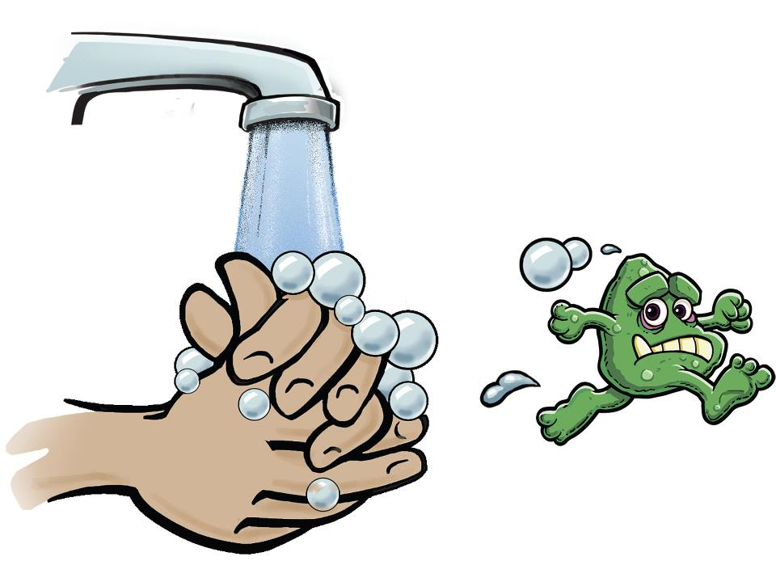
General Guidelines
Practice good hand hygiene
Be sure to clean your hands before taking measurements, especially of children.
Do not handle a child without clean hands.
Likewise, clean your hands after handling a child.
Carry wet napkins, wipes, an alcohol-based hand gel, or a similar product – soap and water may not be available in some households.

Slide 31
General Guidelines
Strive for improvement
You can become skilled in taking anthropometric measurements if you try to improve and follow every step of every procedure the same way every time.
The quality and speed of your measurements will improve with practice.
Focus on what you are doing.
Do not take these procedures for granted even though they may seem simple and repetitious.
Do not omit any of the steps.

Slide 32
ANTHRO TECHNIQUES FOR WOMEN
Preparing to take measurements
Complete identification fields on the paper Module 4A form
As you prepare to take the measurements of the first woman in a household, take out a new data collection form—a paper version of Module 4A, Women’s Anthropometry.
Record all information for the first woman in the ‘WOMAN 1’ column.
If there are multiple women to measure, determine which woman you will measure first.

Slide 33
ANTHRO TECHNIQUES FOR WOMEN
Preparing to take measurements
Complete identification fields on the paper Module 4A form
Complete items 400M through 405:
Item 400M. Record the time (hours and minutes) that you begin the measurement process for the woman.
Item 400B. Record the cluster number and household number.
Item 400D. Record the woman’s name and line number.
Item 405. Ask the woman, “Are you currently pregnant?”
If she is pregnant, do not take her measurements. Skip to Item 405.
If she is not pregnant or is not sure if she is pregnant, take her measurements.

Slide 34
ANTHRO TECHNIQUES FOR WOMEN
Preparing to take measurements
Both the measurer and assistant should:
Wash their hands and remove all jewelry, including rings, watches, and bracelets.
Be aware of any other sharp objects (e.g., pens, pencils, or fingernails), that may interfere or cause harm when taking measurements.
Explain to woman that she should wear only the lightest possible clothing while being weighed.
Explain that bulky clothing and hair ornaments or hairstyles can interfere with the height measurement.
Ask the woman to remove her shoes or sandals and any heavy clothing.
Ask her to also remove, if possible, any hair ornaments or hairstyles, such as ponytails or braids, that will be problematic.

Slide 35
ANTHRO TECHNIQUES FOR WOMEN
Measuring a woman’s weight: summary of procedures
Measurer or assistant
Measurer
1. Set up the scale, if it is not already set up. Place the scale on a hard flat surface and make sure that it is stable
2. Explain to the women that she will step on the scale and stand very still while you take her weight measurement.
3. Switch on the scale, or if the scale is already switched on, press the Start key, while no weight is applied to the scale.
4. Wait until “0.00” appears on the display.
5. Ask the woman to step on the scale and to stand in the middle of the scale, feet slightly apart.

Slide 36
ANTHRO TECHNIQUES FOR WOMEN
Measuring a woman’s weight: summary of procedures
Measurer
Assistant
6. Make sure that the display is not covered by the woman’s feet or skirt
7. Ask the woman to remain still until the weight appears on the display
8. Read the value on the scale display out loud to your assistant
10. Record the value to one decimal place in item 407 of the paper Module 4A form after the measurer confirms that the value is correct.
11. Check the form to make sure the weight is completely and correctly recorded. Instruct the assistant to correct any errors.
9. Repeat the value back to the measurer

Slide 37
ANTHRO TECHNIQUES FOR WOMEN
Measuring a woman’s height: summary of procedures
Measurer or assistant: First set up the board, if it is not already set up.
Place the measuring board on a hard flat surface against a wall, table, tree, staircase, etc.
Make sure the board is stable.
Many walls and floors are not at perfect right angles
If necessary, place small rocks underneath the height board to stabilize it.
If the only level surface to place the board does not have a steady structure against where to lean it, and there are no sturdy pieces of furniture that can be moved behind it, have an adult stand behind the board and provide the support for it not to tip over.

Slide 38
ANTHRO TECHNIQUES FOR WOMEN
Measuring a woman’s height: summary of procedures
Measurer or assistant: Ask the woman to remove her shoes and unbraid or undo any hair that would interfere with the height measurement, if she has not already done so.
Measurer or assistant: Ask the woman to stand on the base of the height measuring board, facing away from the board.
Measurer: Determine if the woman’s heels should be against or away from the back of the height measuring board by observing her profile.

Slide 39
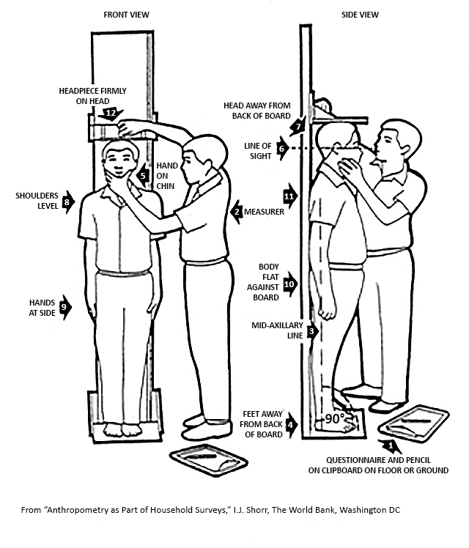
ANTHRO TECHNIQUES FOR WOMEN
An imaginary line from the tip of the woman’s shoulder to her heel (the mid-axillary line; see red line on the figure) should be perpendicular (90°) to the base of the height board (Arrow 3).
For all but extremely thin women, the woman’s buttocks should be against the back of the board and her head and heels should be slightly forward of the back of the board (Arrow 4).

Slide 40
ANTHRO TECHNIQUES FOR WOMEN
Measuring a woman’s height: summary of procedures
Measurer: Position the woman’s heels or knees together as they fall naturally. There are three possibilities. Select whichever combination touches first when the woman stands on the measuring board:
Knees and heels together
Knees together but heels slightly apart
Heels together but knees slightly apart

Slide 41
ANTHRO TECHNIQUES FOR WOMEN
Measuring a woman’s height: summary of procedures
Measurer: Position the woman’s head and upper body:
Ask the woman to look straight ahead.
Cup the woman’s chin between the thumb and index finger of your left hand and gradually close your hand (Arrow 5).
Position the woman’s head so that her line of sight is parallel to the ground (Arrow 6). (With most adults, the back of the head will not touch the back of the board (Arrow 7).)
Release your hand from her chin and ask her to hold her head still.
Make sure the woman’s shoulders are level (Arrow 8), her hands are at her side (Arrow 9), and at least her buttocks touch the back of the measuring board. (With most adults, only the buttocks and perhaps the shoulder blades will touch the back of the board (Arrows 10 & 11).)

Slide 42
ANTHRO TECHNIQUES FOR WOMEN
Measuring a woman’s height: summary of procedures
Measurer: Check the woman’s position. Repeat any of the above steps as necessary until the woman’s position is correct
Measurer: Lower the measuring board headpiece on top of her head, making sure to push through her hair.
Measurer: Read the woman’s height out loud to the nearest 0.1 cm (one decimal place) to your assistant.
Assistant: Confirm the measurement by repeating it back to the measurer.
Assistant: Record the measurement to one decimal place in item 406 of the paper Module 4A form.

Slide 43
ANTHRO TECHNIQUES FOR WOMEN
Measuring a woman’s height: summary of procedures
Measurer: Remove the measuring board headpiece from the woman’s head and help her step off of the measuring board.
Measurer: Check the form to make sure the height is completely and correctly recorded. Instruct the assistant to correct any errors.

Slide 44
ANTHRO TECHNIQUES FOR WOMEN
Completing a woman’s measurements and next steps
When you have completed taking the measurements, thank the woman.
Enter the time (hour and minutes) that you completed the module for that woman in item 400N of the paper Module 4A form.
If there are additional eligible women in the household, repeat the measurement procedure
If there are no additional women eligible, continue on to the next module.

Slide 45
ANTHRO TECHNIQUES FOR WOMEN
Test your knowledge
How do you know the scale is accurate?
By measuring the same person twice
By measuring an object of known weight
By measuring an overweight and an underweight person
There is no way to measure the accuracy of the scale.
What should you do?
You are preparing to take the height measurement of a female respondent.
She has her hair fashioned in an elaborate, high braided style that will not allow for an accurate measurement of her height.
You need to measure her height correctly, but she will not take her braid out.

Slide 46
ANTHRO TECHNIQUES FOR Children
Importance of accurate measurements
Classification of a child being well-nourished or not will depend on the accuracy of your measurements.
The following examples illustrate the impact of a 1 cm measurement error on interpreting malnutrition using percentiles:
Example 1. A 15 month old boy who is 8.0 kg
Length | Percentile Length/Age | Interpretation | Percentile Weight/Length | Interpretation
71 cm | ~3rd percentile | Very stunted | 20th percentile | Not at risk
72 cm | ~5th percentile | Stunted | 8th percentile | Low
73 cm | ~8th percentile | Not at risk | 3rd percentile | Malnourished

Slide 47
ANTHRO TECHNIQUES FOR Children
Importance of accurate measurements
Example 2. A 36 month old girl who is 11.2 kg
Length | Percentile Height/Age | Interpretation | Percentile Weight/Height | Interpretation
87 cm | ~5th percentile | Stunted | 12th percentile | Not at risk
88 cm | ~8th percentile | Low | 8th percentile | Low
89 cm | ~11th percentile | Not at risk | 5th percentile | Malnourished

Slide 48
ANTHRO TECHNIQUES FOR CHILDREN
Preparing to take measurements
Complete identification fields on the paper Module 5A form
As you prepare to take the measurements of the first child in a household, take out a new data collection form—a paper version of Module 5A, Children’s Anthropometry.
Record all information for the first child in the ‘CHILD 1’ column.
If there are multiple children to measure, determine which child you will measure first.

Slide 49
ANTHRO TECHNIQUES FOR CHILDREN
Preparing to take measurements
Complete identification fields on the paper Module 5A form
Complete items 500M through 508:
Item 500M. Record the time (hours and minutes) that you begin the measurement process for the child.
Item 500B. Record the cluster number and household number.
Item 500F. Record the child’s first name and line number.

Slide 50
ANTHRO TECHNIQUES FOR CHILDREN
Preparing to take measurements
Both the measurer and assistant should:
Wash their hands and remove all jewelry, including rings, watches, and bracelets.
Be aware of any other sharp objects (e.g., pens, pencils, or fingernails), that may interfere or cause harm when taking measurements.
Explain to the child’s caregiver that the child should wear only the lightest possible clothing while being weighed.
Explain that bulky clothing and hair ornaments or hairstyles can interfere with the height measurement.

Slide 51
ANTHRO TECHNIQUES FOR CHILDREN
Preparing to take measurements
Ask the caregiver to remove as much of the child’s clothing as possible, or ask permission from the caregiver to remove it yourself.
Never remove any of the child’s clothing without first obtaining permission.
Ask her to also remove, if possible, any hair ornaments or hairstyles, such as ponytails or braids, that will be problematic.
Babies should be weighed naked, but a blanket can be used to keep the baby warm.
First weigh the caregiver who will hold the baby on the scale while he or she is holding the blanket.
Then wrap the naked baby with the blanket and have the caregiver step on the scale with the baby.

Slide 52
ANTHRO TECHNIQUES FOR CHILDREN
Preparing to take measurements
If it is too cold to undress a child or if the child resists being undressed and becomes agitated, weigh the clothed child
Make a note in the margins of the paper Module 5A form that the child could not be undressed to the minimum.
Communicate the circumstances to your field supervisor.
Be sure that that all equipment and other materials (e.g., pens and paper recording forms) are ready before the child is undressed.

Slide 53
ANTHRO TECHNIQUES FOR CHILDREN
Measuring a child’s weight: summary of procedures
Weigh children less than two years old while they are being held by their caregiver using the scale’s 2-in-1 function.
Weigh children 2 years or older who are willing to stand still by themselves alone on the scale.
If a child 2 years old or older jumps on the scale or will not stand still, you will instead use the 2-in-1 weighing procedure used for children less than 2 years old.

Slide 54
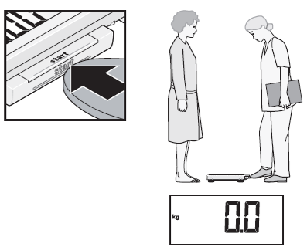
ANTHRO TECHNIQUES FOR CHILDREN
Measuring a child < 2’s weight: summary of procedures
1. First set up the scale, if it is not already set up. Place the scale on a hard flat surface and make sure that it is stable.
2. Switch on the scale, or if the scale is already switched on, press the Start key, while no weight is applied to the scale. Wait until “0.00” appears on the display.
Measurer or assistant

Slide 55
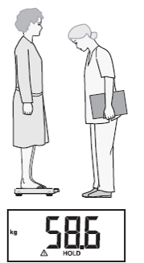
ANTHRO TECHNIQUES FOR CHILDREN
Measuring a child < 2’s weight: summary of procedures
3. Ask the caregiver to step onto the scale. The person’s weight will display.
Measurer
Note: The person being weighed must stand very still for the weight to appear on the display.

Slide 56
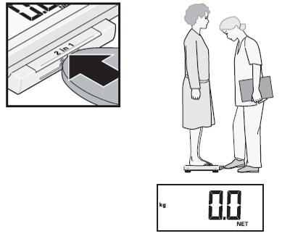
ANTHRO TECHNIQUES FOR CHILDREN
Measuring a child < 2’s weight: summary of procedures
4. Press the 2 in 1 key while the caregiver is still standing on the scale. The scale will store the person’s weight, and “0.00” and the word “NET” will appear on the display.
Measurer

Slide 57
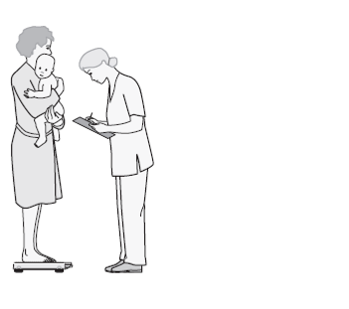

ANTHRO TECHNIQUES FOR CHILDREN
Measuring a child < 2’s weight: summary of procedures
5. Ask the caregiver to take the child to be weighed onto the scale. The caregiver can step off the scale to get the child, in which case “-----” will appear on the display.
Measurer
6. Ask the caregiver to hold the child while standing on the scale and to try not to move

Slide 58
ANTHRO TECHNIQUES FOR CHILDREN
Measuring a child < 2’s weight: summary of procedures
7. Wait until the weight appears on the display and the message “HOLD" is no longer flashing.
10. Repeat the value back to the measurer.
8. Read out the child’s weight to your assistant.
Measurer
Assistant
9. Check the form to make sure the weight is completely and correctly recorded. Instruct the assistant to correct any errors.
11. Record the value to two decimal places in item 518 of the paper Module 5A form after the measurer confirms that the value is correct.

Slide 59
ANTHRO TECHNIQUES FOR CHILDREN
Measuring a child < 2’s weight: summary of procedures
12. Ask the caregiver to step off the scale with the child. The child’s weight will remain displayed.
14. Repeat steps 5–12 for each additional child.
13. Ask the caregiver to step back onto the scale with the next child to be weighed, if there are multiple children under two years to weigh with the same caregiver.
Measurer
Measurer and assistant

Slide 60
ANTHRO TECHNIQUES FOR CHILDREN
Measuring a child < 2’s weight: summary of procedures
Using the 2-in-1 function
The caregiver’s weight will be stored by the scale until the scale turns off or until another person’s weight is saved using the 2-in-1 function.
You can therefore take weight measurements of other children while they are held by the same caregiver.
Another child’s weight measurement is automatically taken as soon as the caregiver steps on the scale holding another child.
You do not need to press the 2-in-1 function key or switch the scale off and on again between measurements.

Slide 61
ANTHRO TECHNIQUES FOR CHILDREN
Measuring a child < 2’s weight: summary of procedures
Using the 2-in-1 function
It is important that the caregiver’s weight does not change between measurements (e.g., by taking off a jacket).
If the caregiver’s weight does change, you should weigh the caregiver alone again and save her new weight using the 2-in-1 function before measuring the weight of additional children.
If you do not take any measurements for 2 minutes, the 2-in-1 function and the scale will automatically switch off, and you will need to start the weighing process from the beginning again.

Slide 62
ANTHRO TECHNIQUES FOR CHILDREN
Measuring a child ≥ 2’s weight: summary of procedures
Measurer or assistant: Set up the scale, if it is not already set up. Place the scale on a hard flat surface and make sure that it is stable.
Measurer or assistant: Explain in a sensitive, non-frightening way to the child that he or she will step on the scale alone and stand very still while you take his or her weight measurement.
Measurer or assistant: Switch on the scale, or if the scale is already switched on, press the Start key, while no weight is applied to the scale.
Measurer: Wait until “0.00” appears on the display.
Measurer: Ask the child to step on the scale and to stand in the middle of the scale, feet slightly apart.

Slide 63
ANTHRO TECHNIQUES FOR CHILDREN
Measuring a child ≥ 2’s weight: summary of procedures
Measurer: Ask the child to remain still until the weight appears on the display.
Measurer: Do not hold or support the child; this will interfere with the measurement.
Measurer: Read the value on the scale display out loud to your assistant.
Assistant: Repeat the value back to the measurer.
Assistant: Record the value 2 decimal places in item 518 of the paper Module 5A form after the measurer confirms the value is correct.
Measurer: Check the form to make sure the weight is completely and correctly recorded. Instruct the assistant to correct any errors.

Slide 64
ANTHRO TECHNIQUES FOR CHILDREN
Measuring a child’s height: summary of procedures
Measure children < 2 years old while they are lying down → Length
Measure children ≥ 2 years old while they are standing up → Height
If the child’s length is measured to 85 cm or more, you must instead measure the child’s height.
Note: A child measured while lying down will appear artificially taller (0.7 cm) than they would if they were measured standing up.

Slide 65
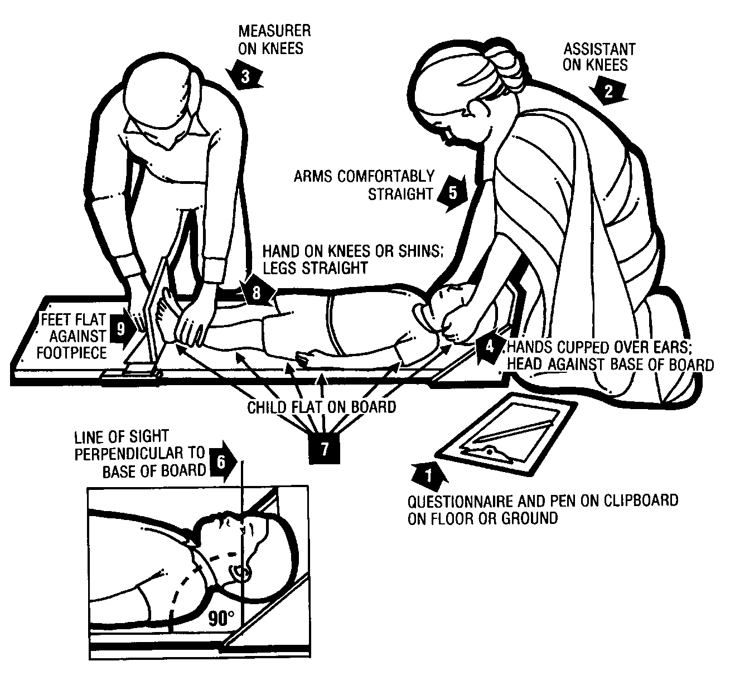
ANTHRO TECHNIQUES FOR CHILDREN
Measuring the length of a child < 2 years old or < 85 cm.

Slide 66
ANTHRO TECHNIQUES FOR CHILDREN
Measuring a child < 2’s length: summary of procedures
Measurer or assistant: Place the measuring board on a hard flat surface, such as the ground, floor, or a steady table, if it is not already set up.
Assistant: Place the paper Module 5A form and pen on the surface next to the board (Arrow 1). Kneel with both knees behind the base of the board, if it is on the ground or floor (Arrow 2).
Measurer: Kneel on the child’s right side so that you can hold the footpiece with your right hand (Arrow 3).

Slide 67
ANTHRO TECHNIQUES FOR CHILDREN
Measuring a child < 2’s length: summary of procedures
Measurer and assistant: With the caregiver’s help, lay the child on the board by doing the following:
Assistant: Support the back of the child’s head with your hands and gradually lower the child onto the board.
Measurer: Support the child at the trunk of the body.
Measurer or assistant: Ask the caregiver to kneel or stand on the opposite side of the board facing the measurer to help keep the child calm.

Slide 68
ANTHRO TECHNIQUES FOR CHILDREN
Measuring a child < 2’s length: summary of procedures
Assistant: Position the child’s head:
Cup your hands over the child’s ears (Arrow 4).
With your arms comfortably straight (Arrow 5), place the child’s head against the base of the board so that the child is looking straight up.
(The child’s line of sight should be perpendicular to the ground (Arrow 6)).
Your head should be straight over the child’s head. Look directly into the child’s eyes.

Slide 69
ANTHRO TECHNIQUES FOR CHILDREN
Measuring a child < 2’s length: summary of procedures
Measurer: Position the child’s legs and feet:
Ensure the child is lying flat and in the center of the board (Arrow 7).
Place your left hand on the child’s shins (above the ankles) or on the knees (Arrow 8).
Press them firmly against the board.
Measurer: With your right hand, place the footpiece firmly against the child’s heels (Arrow 9).
Measurer and assistant: Check the child’s position (Arrows 4-9). Repeat any steps as necessary until the child’s position is correct.
Measurer: Read out loud the measurement to the nearest 0.1 cm (one decimal place).

Slide 70
ANTHRO TECHNIQUES FOR CHILDREN
Measuring a child < 2’s length: summary of procedures
Assistant: Confirm the measurement by repeating it back to the measurer.
Measurer: Remove the footpiece and release your left hand from the child’s shins or knees.
Assistant: On the paper Module 5A form:
Record the measurement one decimal place in item 516
Circle ‘1’ (LYING DOWN) in item 517.
Measurer: Check the form to make sure the length is completely and correctly recorded. Instruct the assistant to correct any errors.
Measurer and assistant: If the child’s length is ≥ 85 cm, re-measure the child while he or she is standing up.

Slide 71
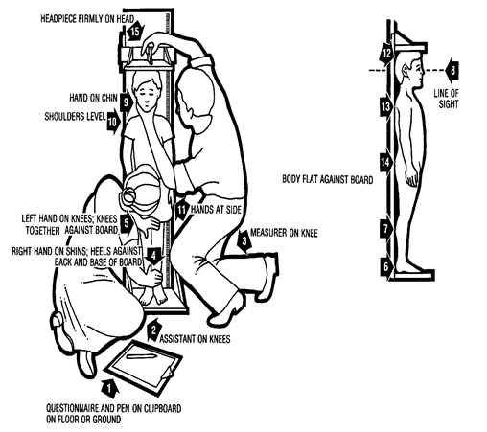
ANTHRO TECHNIQUES FOR CHILDREN
Measuring the height of a child ≥ 2 years old or ≥ 85cm.

Slide 72
ANTHRO TECHNIQUES FOR CHILDREN
Measuring a child ≥ 2’s height: summary of procedures
Measurer or assistant: Set up the board, if it is not already set up.
Place the measuring board on a hard flat surface against a wall, table, tree, staircase, etc.
Make sure the board is stable.
Many walls and floors are not at perfect right angles
If necessary, place small rocks underneath the height board to stabilize it.
If the only level surface to place the board does not have a steady structure against where to lean it, and there are no sturdy pieces of furniture that can be moved behind it, have an adult stand behind the board and provide the support for it not to tip over.

Slide 73
ANTHRO TECHNIQUES FOR CHILDREN
Measuring a child ≥ 2’s height: summary of procedures
Measurer or assistant: Ask the caregiver to remove the child’s shoes and socks and unbraid or undo any hair that would interfere with the height measurement, if she has not already done so.
Measurer or assistant: Ask the caregiver to walk the child to the board and to kneel in front of the child so that he or she can comfort the child during the measurement process.
Assistant: Place the paper Module 5A form and pen on the ground (Arrow 1). Kneel with both knees on the child’s right side (Arrow 2).
Measurer: Kneel on your right knee only, for maximum mobility, on the child’s left side (Arrow 3).

Slide 74
ANTHRO TECHNIQUES FOR CHILDREN
Measuring a child ≥ 2’s height: summary of procedures
Assistant: Position the child’s feet and legs:
Place the child’s feet flat and together in the center of and against the back of the base of the board.
Place your right hand just above the child’s ankles on the shins (Arrow 4), your left hand on the child’s knees (Arrow 5), and push against the board.
Make sure the child’s legs are straight and the heels and calves are against the board (Arrows 6 and 7).
Tell the measurer when you have completed positioning the feet and legs.

Slide 75
ANTHRO TECHNIQUES FOR CHILDREN
Measuring a child ≥ 2’s height: summary of procedures
Measurer: Position the child’s head and upper body:
Tell the child to look straight ahead at the caregiver if he or she is in front of the child.
Make sure the child is looking straight ahead and his or her line of sight is level with the ground (Arrow 8).
Place your open left hand on the child’s chin. Gradually close your hand around the chin (Arrow 9). Do not pinch the jaw. Do not cover the child’s mouth or ears.
Make sure the child’s shoulders are level (Arrow 10), the hands are at the child’s side (Arrow 11), and the head, shoulder blades, and buttocks are against the board (Arrows 12, 13 and 14).

Slide 76
ANTHRO TECHNIQUES FOR CHILDREN
Measuring a child ≥ 2’s height: summary of procedures
Measurer and assistant: Check the child’s position (Arrows 6-14). Repeat any steps as necessary.
Measurer: With your right hand, lower the headpiece on top of the child’s head. Make sure you push through the child’s hair (Arrow 15).
Measurer: Read the measurement out loud to the nearest 0.1 centimeter.
Assistant: Confirm the measurement by repeating it back to the measurer.
Assistant: On the paper Module 5A form:
Record the measurement to one decimal place in item 516
Circle ‘2’ (STANDING UP) in item 517.

Slide 77
ANTHRO TECHNIQUES FOR CHILDREN
Measuring a child ≥ 2’s height: summary of procedures
Measurer: Remove the headpiece from the child’s head and remove your left hand from the child’s chin.
Measurer: Check the form to make sure the height is completely and correctly recorded. Instruct the assistant to correct any errors.
Measurer and assistant: If the child’s length is < 85 cm, re-measure the child while he or she is lying down.

Slide 78
ANTHRO TECHNIQUES FOR CHILDREN
Completing children’s measurements and next steps
When you have completed taking the measurements, thank the caregiver and child.
Enter the time (hour and minutes) that you completed the module for that child in item 519 of the paper Module 5A form.
If there are additional eligible children in the household, repeat the measurement procedure
If there are no additional children eligible, continue on to the next module.

Slide 79
ANTHRO TECHNIQUES FOR CHILDREN
Test your knowledge
If you measured a 26 month old to be 83 cm, what should you do?
(Select all that apply.)
If measured lying down, you do not need to do anything.
If measured lying down, re-measure her standing up.
If measured standing up, re-measure her lying down.
If measured standing up, you do not need to do anything.
What should you do?
You are preparing to weigh a 30 month old child.
As his caregiver tries to remove his shorts and t-shirt, the boy protests.
He lays down on the floor kicking and waving his arms while yelling and crying.
Other children in the household are watching. An infant also starts to cry.

Slide 80
PRACTICING TAKING MEASUREMENTS
Introduction
It is important to practice taking height and weight measurements before fieldwork begins
You will practice measuring, reading, and recording the heights, lengths, and weights of women and children.
This hands-on experience will:
Develop your skills.
Give you confidence.
Allow trainers to provide you with feedback and correct any mistakes.

Slide 81
PRACTICING TAKING MEASUREMENTS
Goals of practice session
Precise:
You can repeat your measurements with minimal variation.
Accurate:
You can take measurements close to the “true” weight.
To ensure all measurers and assistants understand and adhere to the measurement procedures
To ensure the measurements are precise and accurate.
Practice will minimize measurement variability within measurers and between measurers and help to ensure that the measurements are comparable across field teams and also across ZOI surveys.

Slide 82
Disclaimer:
This publication was prepared for review by the United States Agency for International Development. It was prepared for the Bureau for Food Security, United States Agency for International Development, USAID Contract Number GS-23F-8144H/AID-OAA-M-12-00006.
The authors’ views expressed in this publication do not necessarily reflect the views of the United States Agency for International Development or the United States government.
Recommended Citation:
Jasbir Kaur, Kirsten Zalisk, and Kiersten B. Johnson. 2018. Feed the Future Survey Methods Guidance: Anthropometry Training Slides. Washington, DC: Bureau for Food Security, U.S. Agency for International Development.
Contact Information:
Feed the Future
1300 Pennsylvania Ave, NW
Washington, DC 20004
www.feedthefuture.gov

